Slide 1
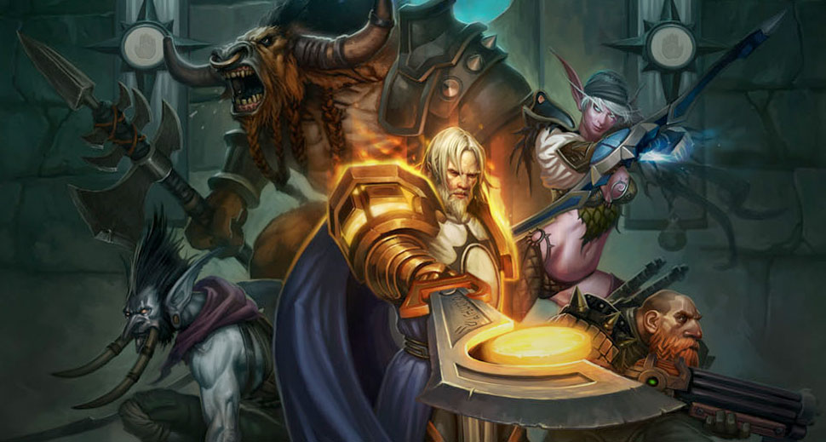
GA 3331 – Game Prototyping
Week 6
Target audiences and Multiplayer gameplay

Slide 2
Show me your moves (homework)
Hand back quizzes
Homework back next week.

Slide 3
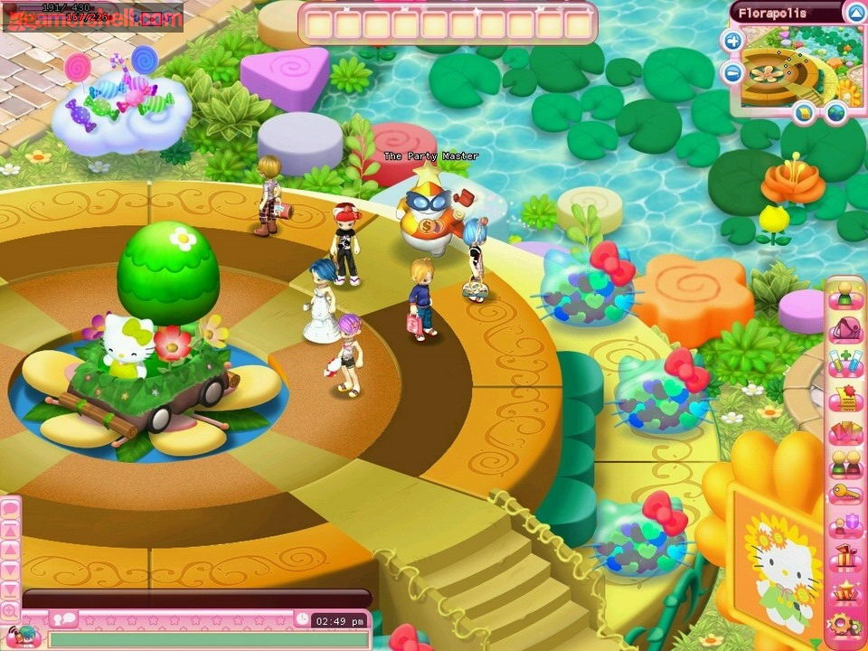
Hello Kitty Island Adventure – AKA Gangster Island
Notes:
Who has played this, and why?

Slide 4
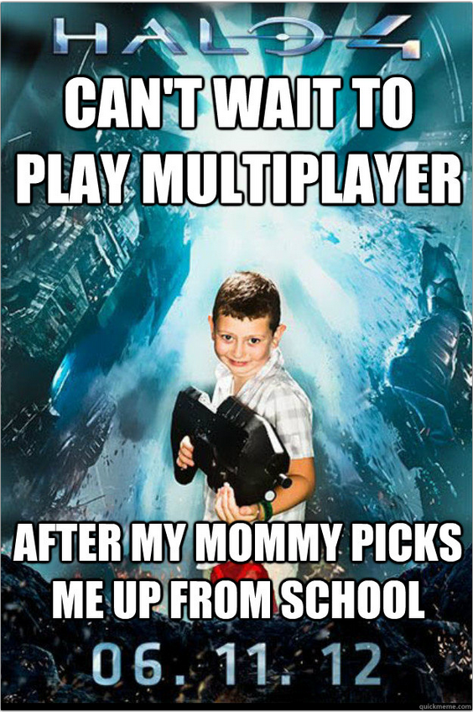
“Demographics”
Children
Competitive gamers
Social Gamers
Professional players
Families
Mass Market
Notes:
Designing for different players
Children – Typically playing a game to have fun. These games tend to have few, if any player decisions, and have strong elements of chance
Competitive gamers – Bowling/Chess, prefer games with more skill, head to head
Social gamers – don’t care too much about intense strategy
Professional players – Very strong skill
Families – Mix of people
Mass market – broad range

Slide 5
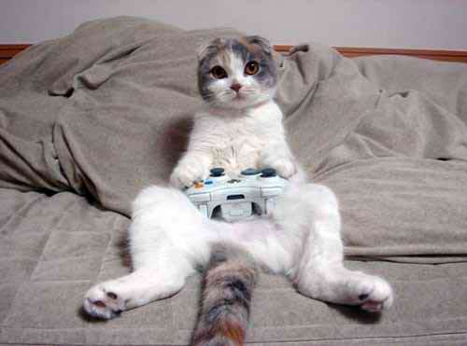
Abilities of the target market, and cats.
Reading ability
Learning Curve
Physical ability
Notes:
Reading ability – 4-5 year olds, young adults
Learning Curve – nintendo DS and its pen, use pre-existing knowledge
Physical ability – Microsoft controller

Slide 6
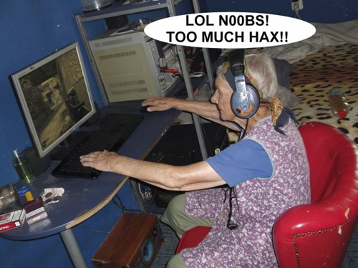
New vs experienced players
Life meters
Hit points
Subscreens
HUDs
Notes:
The learning curve

Slide 7
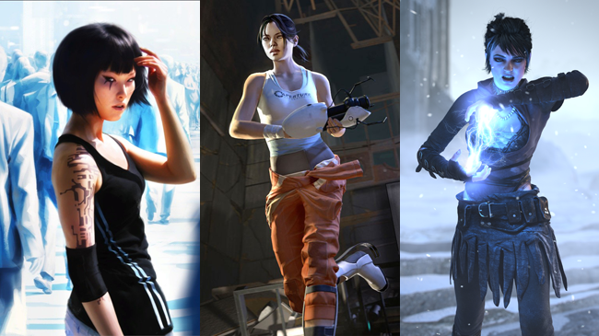
More abilities to consider of your market
Cognitive abilities
Learning Style
Tactical Desires
Notes:
Cognitive ability – Risk for 6 year olds vs Monopoly for adults
Learning style – Men Vs Women

Slide 8
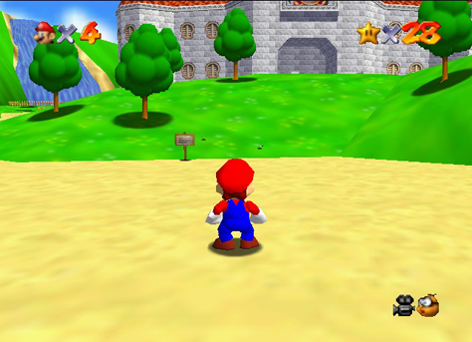
The “Mass Market”
Targeting a specific market is the opposite of the “Mass Market”
Try to sell to as wide a range as possible across all demographics
Have a deeper understanding of a broad range of demographics
Try to avoid excluding anyone

Slide 9
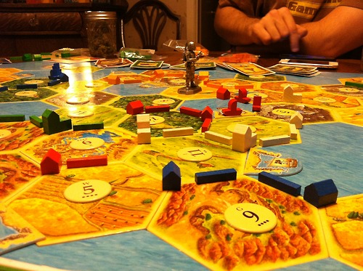
“Eurogames”
Typically played in 20-90 minutes
Short setup time
Simple rules, short learning curve
Cooperative, no confrontational
Has strategic decision making
Minimal player downtime
Notes:
Typically played in 20-90 minutes
If it’s too short, adults feel like it’s over too quickly. Too long and children don’t like it
Short setup time
No fun setting up
Simple rules, short learning curve
Easy to learn, hard to master
Cooperative, no confrontational
Trading/negotiation, coop
Has strategic decision making
Not a huge amount of luck
Minimal player downtime
Players don’t like waiting for their turn

Slide 10
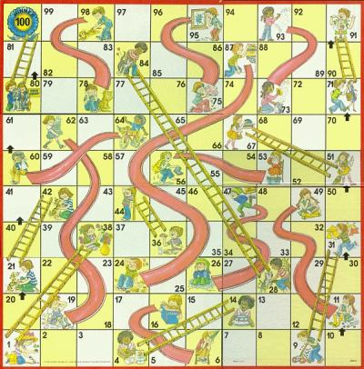
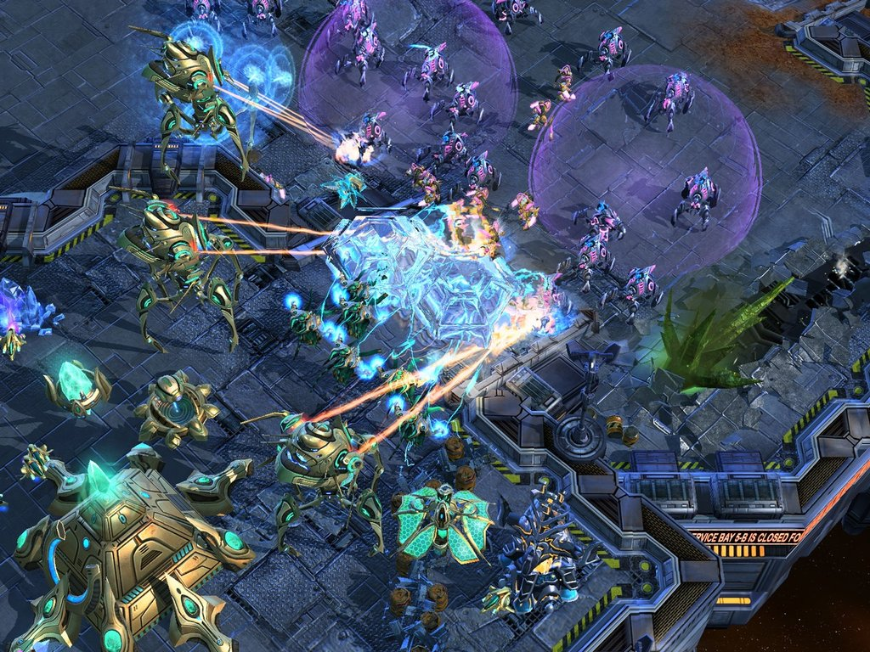
When I Win, It’s Skill; When You Win, It’s Luck
Some games are all chance, and have no skill-based player decisions
Chutes and Ladders
Gambling games (Roulette)
Some games are all skill
Tic-tac-toe
Chess/go/Starcraft
Many games fall between
Settlers of Catan, Backgammon, Poker
Twitch vs Strategy
Notes:
Games of chance – Typically children’s agme or gambling games. A small amount of strategy is acceptable, turns it into a family game
The “ILLUSION” of skill
Games of skill – Twitch based games (FPS),
Strategy vs twitch skill

Slide 11
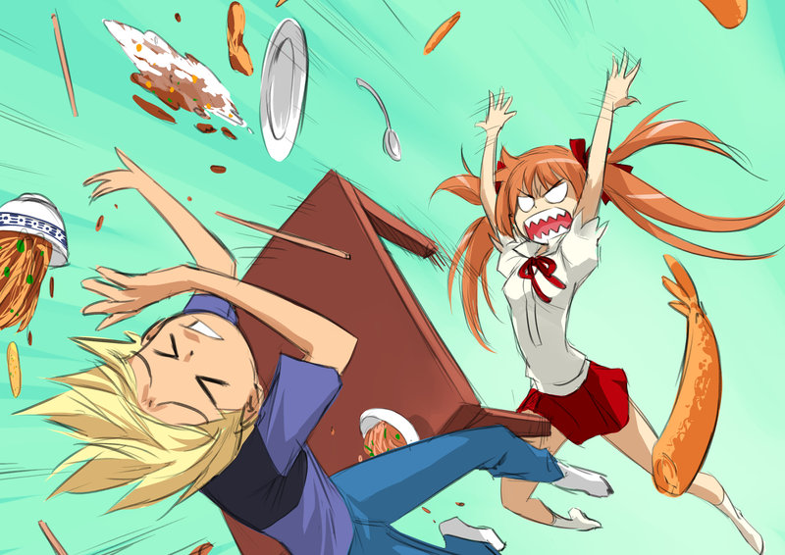
Signs that your game isn’t balanced
Players are bored
Too much luck
Players are bored except on their turn
Players aren’t engaged or confused
Game is too complicated
One player beats all of the other players by a wide margin
Maybe too much skill.
Consider a catch-up mechanic

Slide 12

Lab #1 In class challenge
FPS for girls 8-16 years old
Using the DDR dance pad for five different uses
Better if it doesn't involve dancing
Make a game intended for wal-mart shoppers
Mass Market appeal for non-gamers
Educational MMO

Slide 13
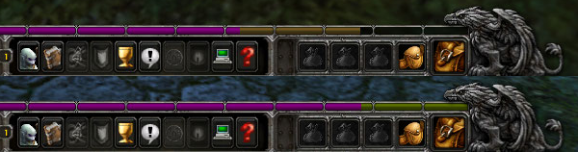
Rewards instead of punishments - "Framing"
WoW EXP rested bonus
Examples of other types of framing?
Notes:
In World of Warcraft what they did when they first designed the game was they had an experience system that would, over time, lower the amount of experience you got because [Blizzard] wanted to encourage people to play for like two hours at a time instead of twelve hours at a time. So the longer you played you’d get this experience degradation and then it would bottom out and at that point it would be a fixed rate of experience. And people just hated it.
And so they went back and [Blizzard's Rob Pardo] was like allright, basically what we did was we made everything in the game take twice as much experience to achieve as before and then we flipped it. So actually what happens is you start getting 200% experience and eventually it goes back down to 100%. So that effectively now how they spin it is that if you log out for a while you get this 200% boost when you log back in! And then over time it goes away and you just get regular 100% experience. It’s EXACTLY the same as it was before, except NOW everyone is like “Fuck yeah, Blizzard, this is exactly what I want!”

Slide 14
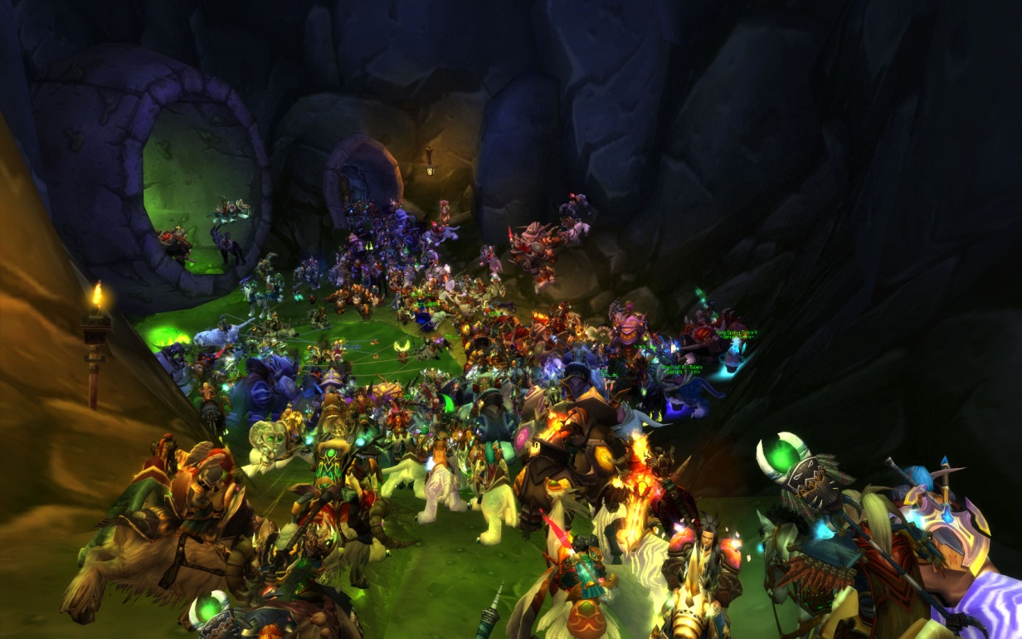
Multiplayer games
How do you separate different multiplayer games?
Number of players
2 players versus thousands(Massively Multiplayer)

Slide 15
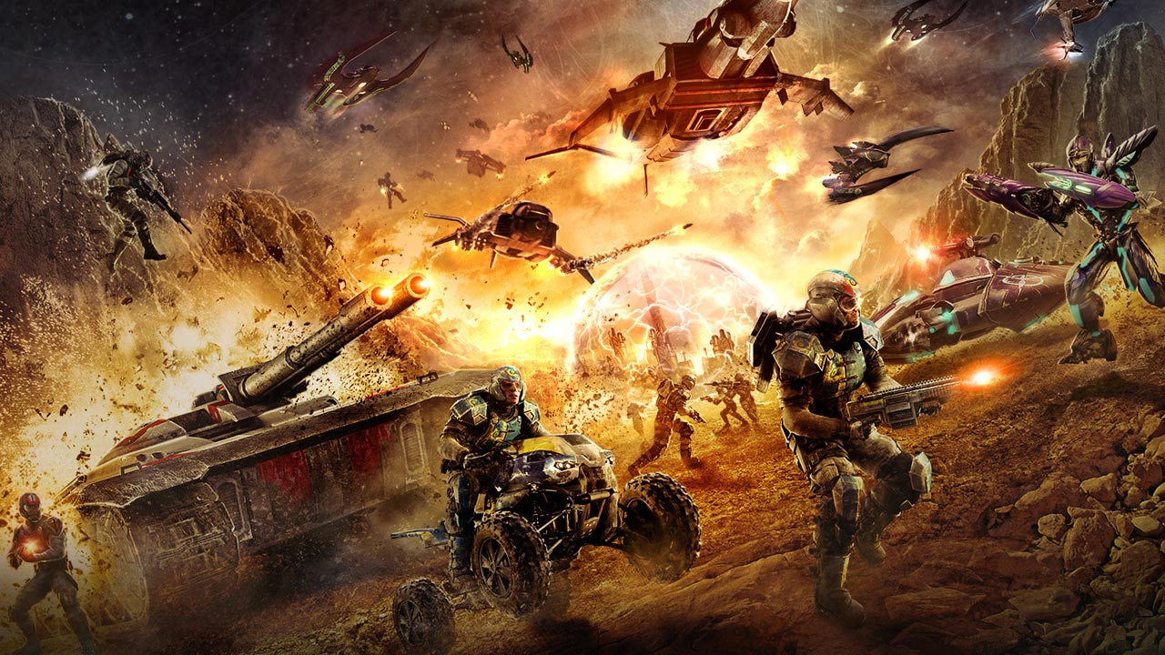
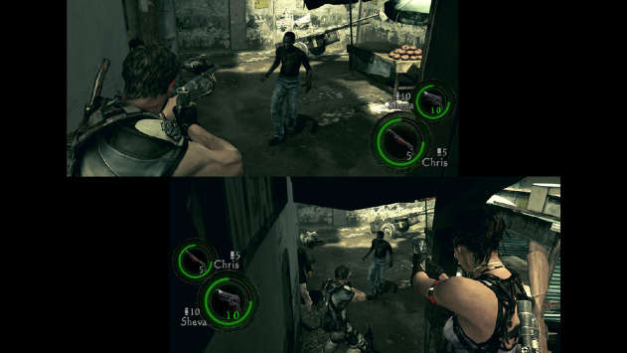
The players make the difference.
Two – Eight player games
More than Eight
Thousands-Millions
Notes:
Two player games
Don’t’ have to worry about trading/negotiation
Four-Eight player games
More rare seeing free-for-all gameplay
Team play more common
Thousands-Millions
Have to start answering the question: How can a single player make a difference?

Slide 16
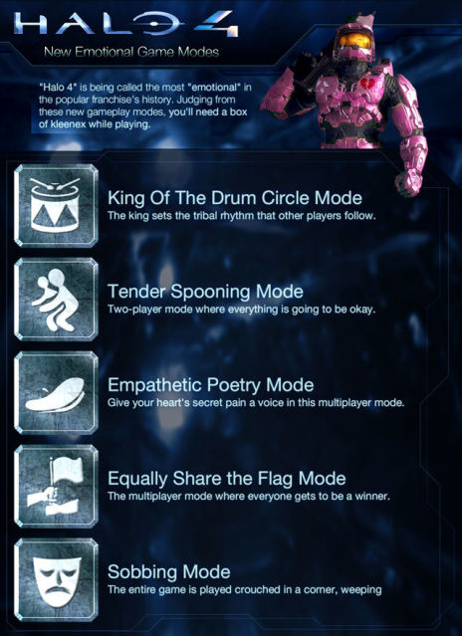
What kind of play are we talking about?
Real Time
Turn based
Competitive
Cooperative
Usually games are a mix of these
Notes:
Multiplayer
Synchronous or ascynrhonous?
Most games offer mix, and let the player choose what they like

Slide 17
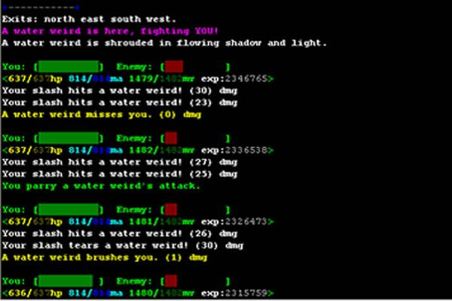
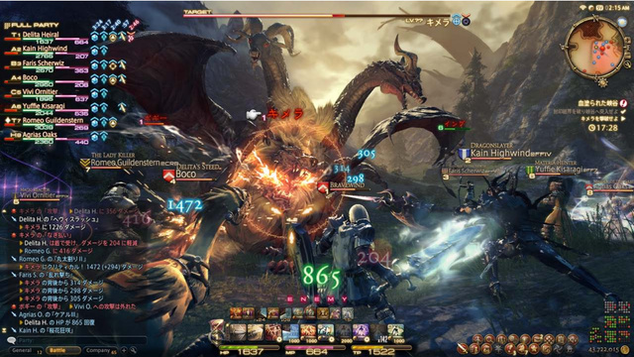
Technology based
MUDs
MMO
LAN
Services like xbox live/steam

Slide 18
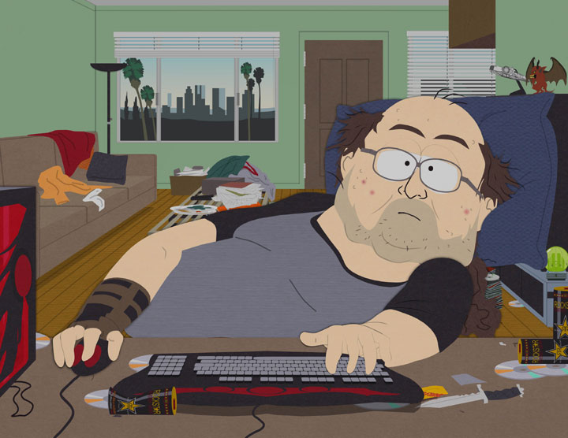
How do you kill that which has no life?
Notes:
You have to consider dynamic scalability. Players go in and out
Griefing
Community formation and support
Attracting new and old players
Issues with interfaces

Slide 19

Lab #2 Playtest unreal tournament deathmatch, and improve it

Slide 20
Lab #3 (if time), start on bombing run

